Slide 1
WRITING FUNCTIONS IN R
TEAM 11
Nash Kleisner, Jill Maguire, Jennifer Zhang, and Yixuan Zhu
Notes:
Functions in the background that we use all the time
(sum, standard deviation ..)

Slide 2
Agenda
Concept/How-to
Exercise
Poll

Slide 3
What is a function and why do we use them?
A function is a tool used to break down a program into smaller reusable pieces.
We use functions to make our code more readable, avoid errors, and to be more productive.
Having a long drawn out script can be hard to understand exactly what is happening.
Statistically speaking, the more code you have to write, the more errors you will encounter and the longer it takes to finish.

Slide 4
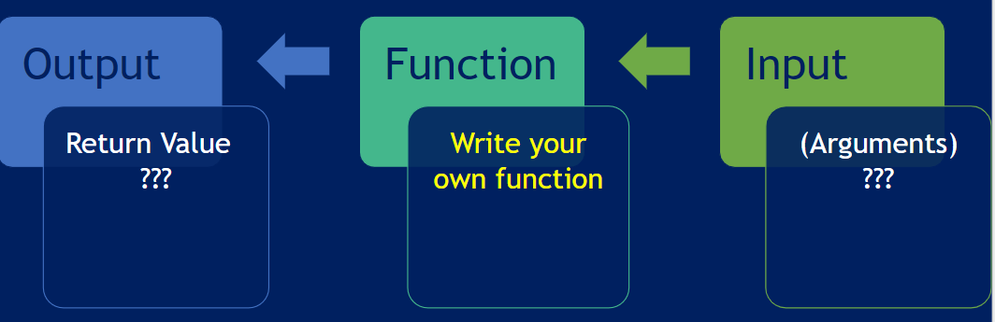
Syntax for Writing a Function
func_name <- function (argument) {
statement
}

Slide 5
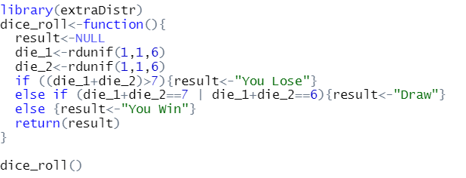
Recall - If Statement in a Function
Rolling Dice
Objective: Create a function called dice_roll() that takes no arguments and returns “You Win”, “Draw” or “You lose”.
Explanation: The function simulates the roll of two fair dice. Each die can take a value from one to six. If the toss adds up to a value greater than seven the house wins. If the dice add up to seven or six there is a draw. If the dice add up to less than six you win.

Slide 6
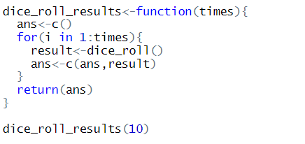
Recall - For Loop in a Function
Simulating Several Tosses
Objective: Create a function called dice_roll_results() that takes a single argument called times. The function should return a vector of results obtained from the dice_roll() function. The length of the vector should be times.
Explanation: The new function should call the function generated in the last slide. The user will provide the number of times they want to roll the dice and the function should return the results (“You Win”, “Draw”, “You Lose”) in a vector of size times. Try times =10

Slide 7
return()
Returns a SINGLE object
R will return the last output of a function
Makes R code easier to understand - good practice even if unnecessary

Slide 8
Empty parameter example
helpme <- function(){
print("You're amazing, sweetie!!!")
}
helpme()
> “You’re amazing, sweetie!!!”

Slide 9
Parameter example
DoctorProfessorRachelChung <- readline(prompt = "Enter any number between 1 to 10 : ")
ratemyprof <- function(n){
if (n != 10){print("Incorrect, your professor is amazing!!!")}
else{print("Your professor is 10/10!!!")}
}
ratemyprof(DoctorProfessorRachelChung)
> Your professor is 10/10!!!

Slide 10
Using return()
using_return <- function() {
my_list <- list("color" = "red", "size" = 20, "shape" = "round")
return(my_list)
}
a <- using_return()
a$color > red
a$size > 20
a$shape > round

Slide 11
Good rules to follow
Make sure your function name refers to what your function does
Be sure to not name your function after any of the existing R functions
Make function as generic/versatile as possible to be used in a broad range of applications to simplify code (parsimony)
A function should be concise and perform a single operation
A long and complex function is missing the whole point

Slide 12
Things to avoid
ENTIRE function needs to be wrapped in curly braces {NOT parentheses}
Wrap your curly braces correctly!
“Unexpected “}“ in “}“
Last thing evaluated is what will be returned unless otherwise specified
Careful { }, ( ) when use if statement and for loop together

Slide 13
Bug!
DoctorProfessorRachelChung <- 10
ratemyprof <- function(n){
If {n != 10
print("Incorrect, your professor is amazing!!!")}
else{print("Your professor is 10/10!!!")
}
}
> Error: unexpected '}' in "}"

Slide 14
Another bug!
multiply <- function(a,b){
a*b
}
multiply(3)
> Error in multiply(3) : argument "b" is missing, with no default

Slide 15
Exercise: 4-15

Slide 16

(a) Write a function, Power(), that prints out the result of raising 2 to the 3rd power. In other words, your function should compute 2³ and print out the results.
Hint: Recall that x^a raises x to the power a. Use the print() function to output the result.

Slide 17
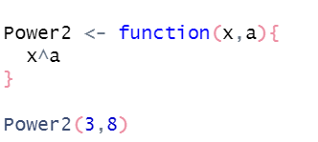
(b) Create a new function, Power2(), that allows you to pass any two numbers, x and a, and prints out the value of x^a. You can do this by beginning your function with the line
> Power2 <- function (x, a) {
You should be able to call your function by entering, for instance, > Power2(3, 8)
on the command line. This should output the value of 3⁸, namely, 6561.

Slide 18

(c) Using the Power2() function that you just wrote, compute 10³, 8¹⁷, and 131³.
Hint：Put the base at front in the parentheses, and index at back.

Slide 19

(d) Now create a new function, Power3(), that actually returns the result x^a as an R object, rather than simply printing it to the screen. That is, if you store the value x^a in an object called result within your function, then you can simply return() this result, using the following line:
return (result)
The line above should be the last line in your function, before the } symbol.

Slide 20
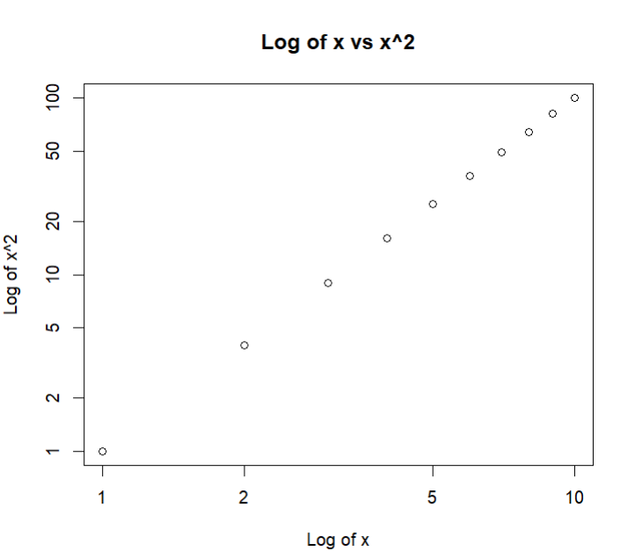

(e) Now using the Power3() function, create a plot of f(x) = x². The x-axis should display a range of integers from 1 to 10, and the y-axis should display x². Label the axes appropriately, and use an appropriate title for the figure. Consider displaying either the x-axis, the y-axis, or both on the log-scale. You can do this by using log = "x", log = "y", or log = "xy" as arguments to the plot() function.

Slide 21
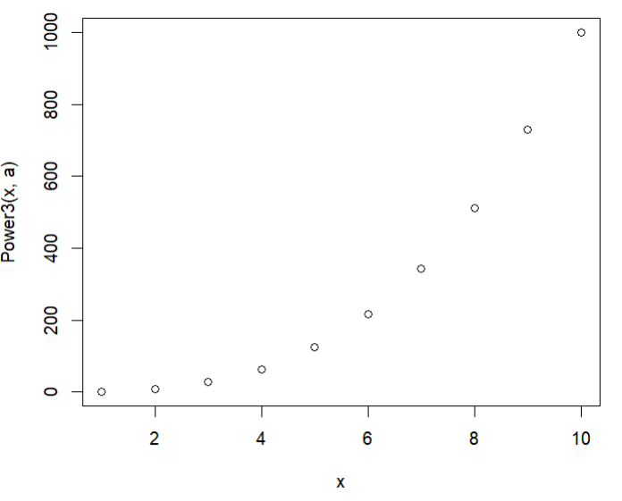

(f) Create a function, PlotPower(), that allows you to create a plot of x against x^a for a fixed a and for a range of values of x. For instance, if you call
> PlotPower(1:10, 3)
then a plot should be created with an x-axis taking on values 1, 2,..., 10, and a y-axis taking on values 1³, 2³,..., 10³.

Slide 22

Poll
https://pollev.com/jillmaguire606

